Slide 1

Cloud Computing
CI / CD of project
By Avgustin Chynarbekov | Dr.Ahmad
For Midterm project

Slide 2
Goal & Motivation
Demonstrate a complete CI/CD pipeline on a manageable project.
Provide a repeatable process for testing, packaging, and sharing code.
Deliver assets that are easy to review (web UI, API, documentation).
Show why automation reduces risk vs. manual deployments.
Photos of the project will be on the last slides.

Slide 3
Architecture Overview
Stack: Node.js with Express backend, vanilla HTML/CSS frontend, Jest with Supertest.
Endpoints: / for UI, /status for live status JSON, /api/info for course-specific message.
Static documentation hosted from docs/ through GitHub Pages.
CI implemented with GitHub Actions running lint and tests.Visual flow: Developer → GitHub repo → Actions → Pages plus API consumers.

Slide 4
Implementation Details
Express serves JSON endpoints and static assets from public/.
Status payload includes professor name, environment, timestamp, CI hint.
Frontend fetches /status and /api/info to display live data on the page.
Tests cover /api/info, /status, /health to ensure reliability.
Code quality verified using ESLint and Prettier.

Slide 5
CI Pipeline (GitHub Actions)
Workflow ci.yml triggers on every push or pull request to main.
Steps: checkout code, configure Node 20, run npm ci, npm run lint, npm test.
Pipeline fails fast if lint or tests fail; badge embedded in README and Docs shows status.
Screenshot idea: Actions run with green check marks.
Github page link: https://npaugust.github.io/cloud-ci-showcase/

Slide 6
CD & Demo Assets
GitHub Pages publishes docs/ with project overview and future download links.
Express serves the local demo UI at http://localhost:8080./status JSON output proves live backend data (includes “Professor: Dr. Ahmad”).
Reproduction instructions: clone repo, npm install, npm run dev.
Screenshot idea: Pages site, UI window, /status response.

Slide 7
Lessons Learned & Next Steps
CI/CD keeps the project always ready for review and sharing.
GitHub Pages offers a quick documentation outlet tied to the repo.
Next improvements: containerize API, auto-deploy to a cloud host, add integration tests and security scans.
Plan to attach PDF presentation and packaged release once pipelines run in GitHub.

Slide 8
Screenshot’s time!
NEXT SLIDES ARE:
1) Local UI (Express Frontend)
“Live dashboard served by Express. Shows current status payload (environment, timestamp, Dr. Ahmad) fetched from /status and /api/info.”
2) Local API JSON
“Raw JSON response from /status. Evidence that backend is running locally and returns the same data consumed by the UI.”
3) GitHub Repository Overview
“Repository structure with source code, workflows, docs, and presentation. Everything stored publicly for review.”
4) GitHub Actions – CI Run
“Workflow CI triggered on push. Steps: checkout → Node setup → npm ci → lint → tests. Run succeeded (green badge).”
5) GitHub Pages Site
“Documentation site published from docs/. Explains the project, CI/CD pipeline, and provides download links.”

Slide 9
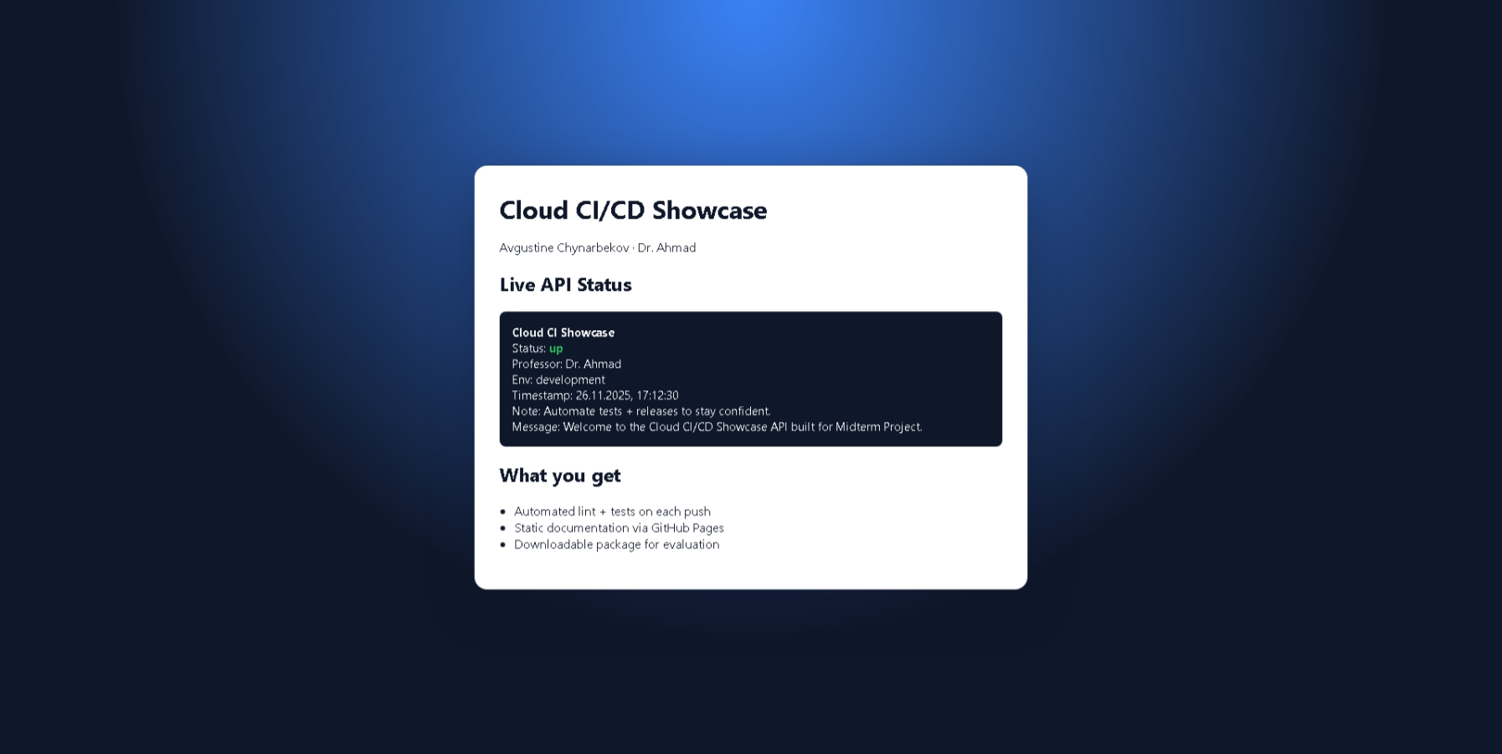
Localhost:8000/ everything is good.

Slide 10
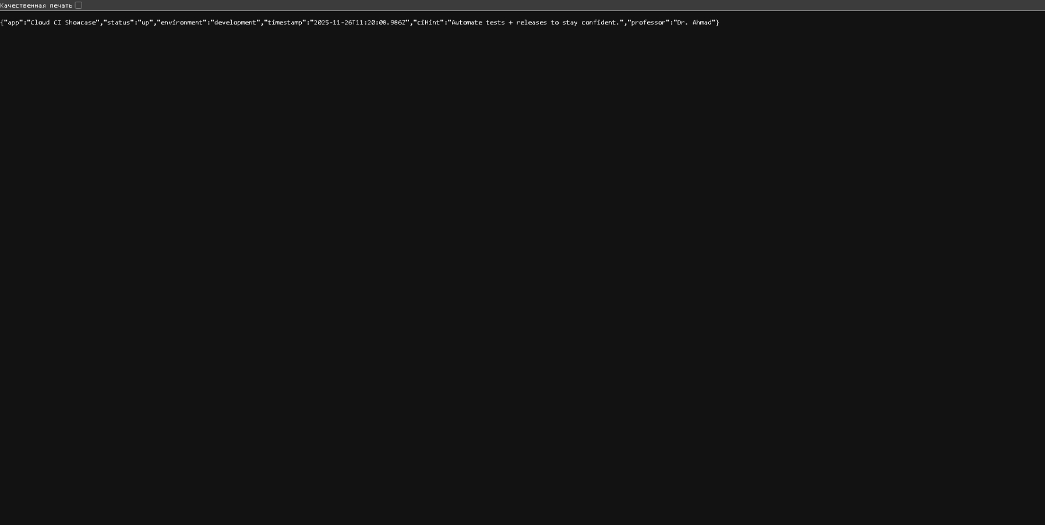
Localhost:8000/status everything is good.

Slide 11
Next screenshot is Cloud CI/CD Showcase
From github.io page.
Please scroll to up\down to see all.

Slide 12
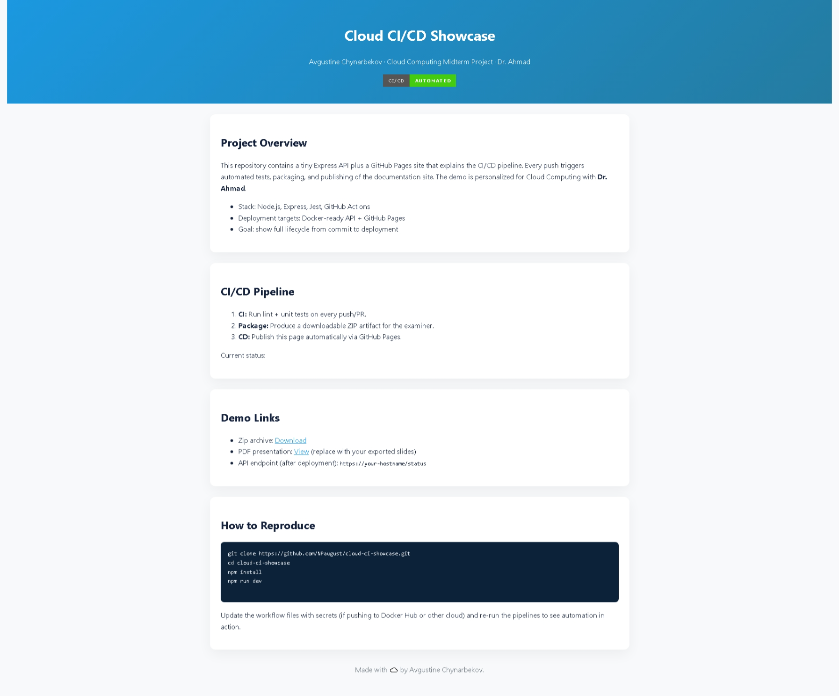
asd

Slide 13
Next screenshot is NPaugust/cloud-ci-showcase
Project repository in Github.
Please scroll to up\down to see all.

Slide 14
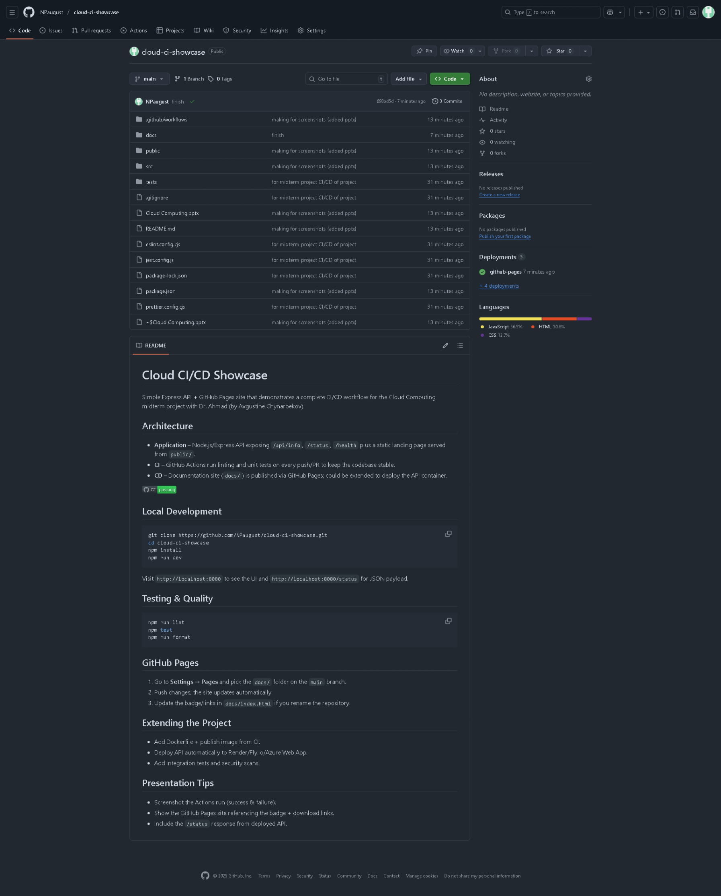

Slide 15
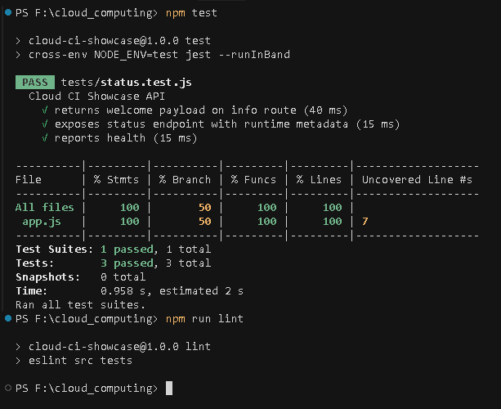
Tests

Slide 16
Conclusion
After all, I built a small but complete CI/CD showcase with Express, static docs, and automated tests.
Github Actions keep every commit validated, Github Pages exposes project story
Every documentations exists, for analyzing and learning how to do run my project very easily.
This presentation done by short time but anyway,
Thank you for watching it!
Avgustin Chynarbekov

